Slide 1
FACE RECOGNITION ATTENDANCE SYSTEM
MANIDEEP NADIMPELLI
BHAVYA SRI SIRASANAGANDLA
ESWAR VALLURU

Slide 2
Motivation:
The management of the attendance can be a great burden on the teachers if it is done by hand.
To resolve this problem, smart and auto attendance management system is being utilized. But authentication is an important issue in this system.
The smart attendance system is generally executed with the help of biometrics. Face recognition is one of the biometric methods to improve this system.
Being a prime feature of biometric verification, facial recognition is being used enormously in several such applications, like video monitoring and CCTV footage system, an interaction between computer & humans and access systems present indoors and network security.

Slide 3
Objective
To mark the attendance by student’s face recognition

Slide 4
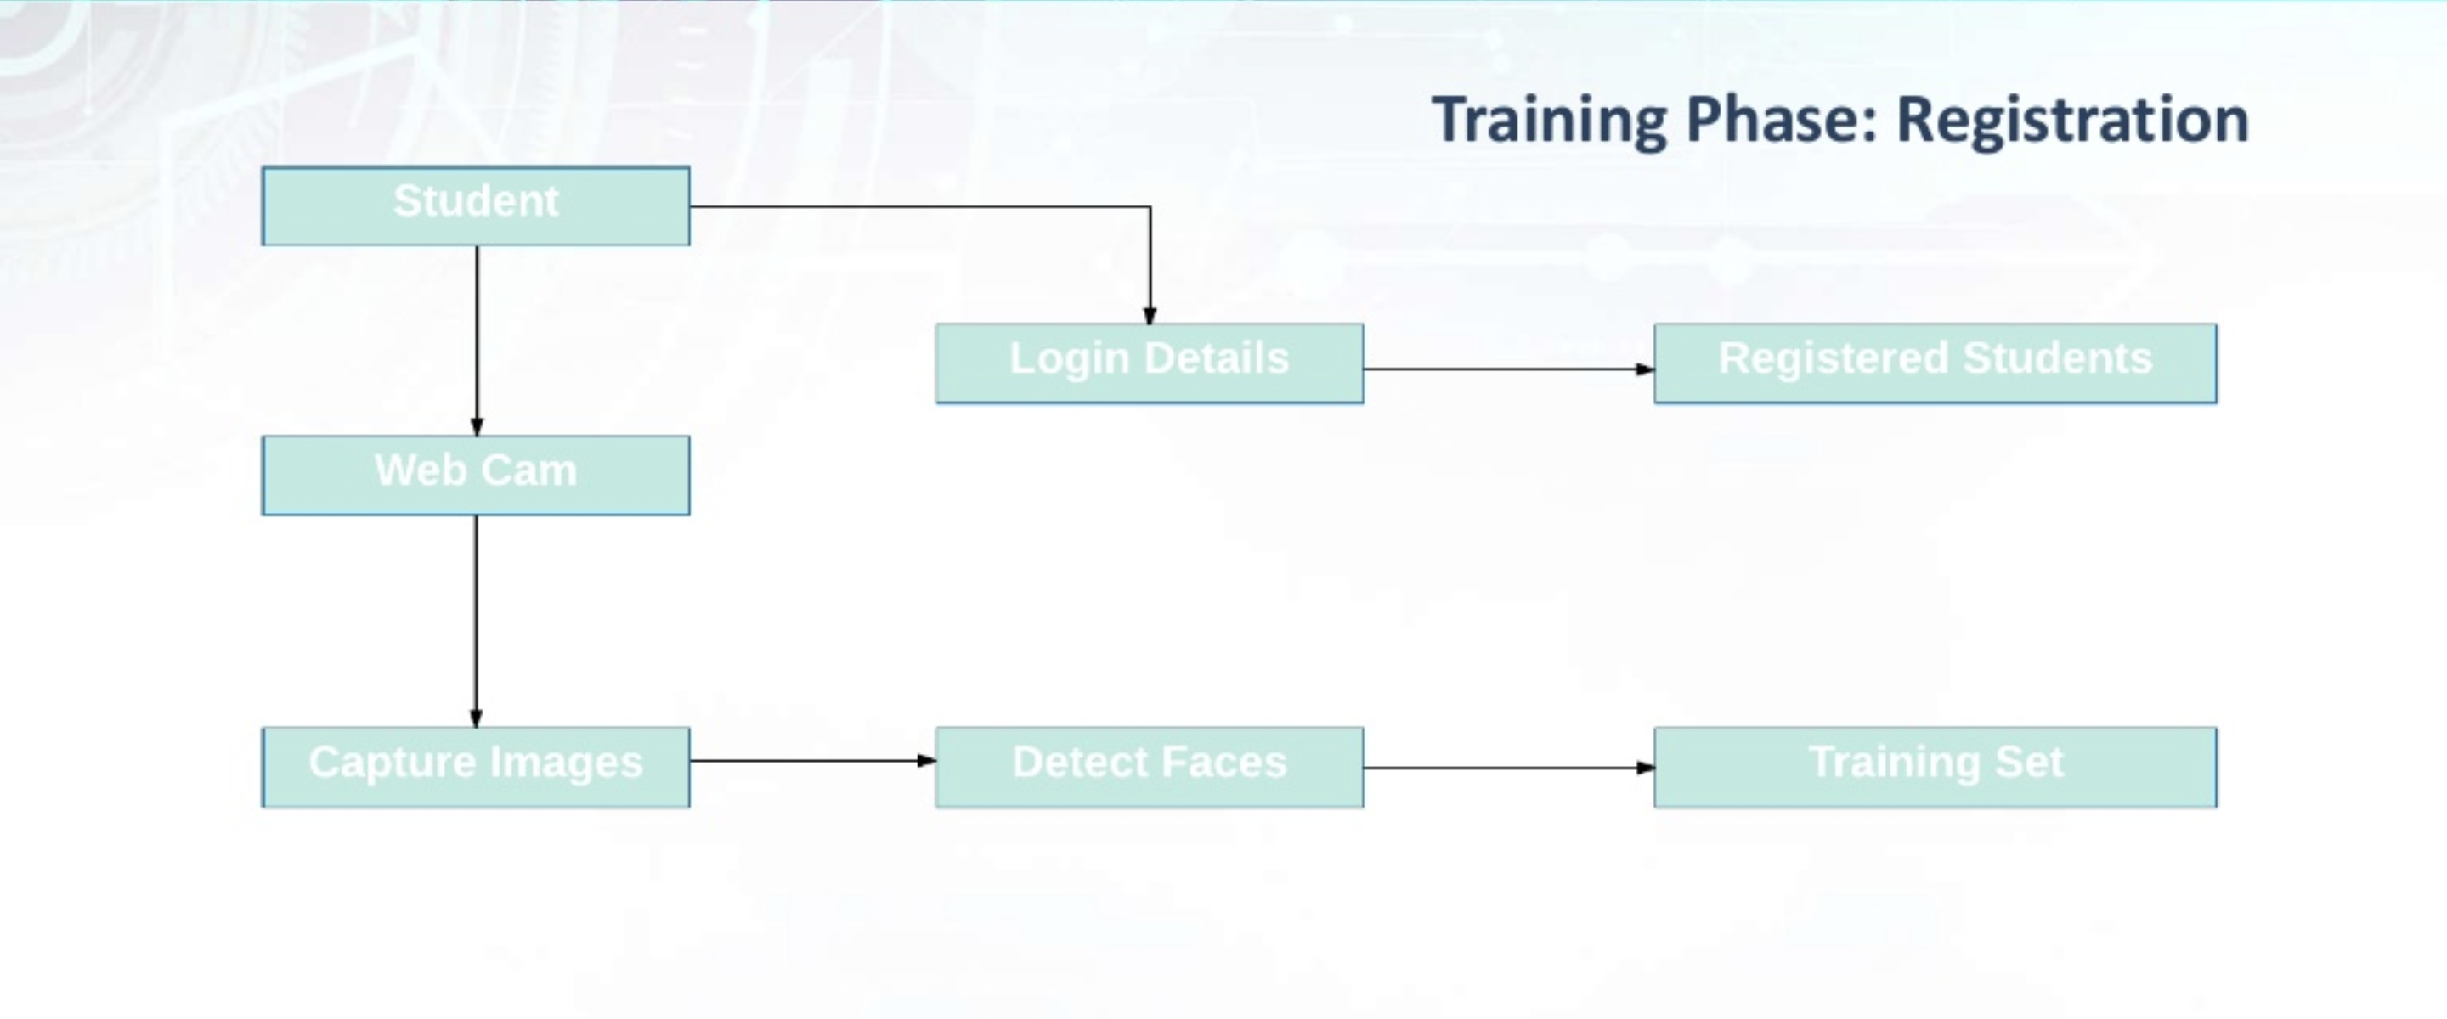
Implementation

Slide 5
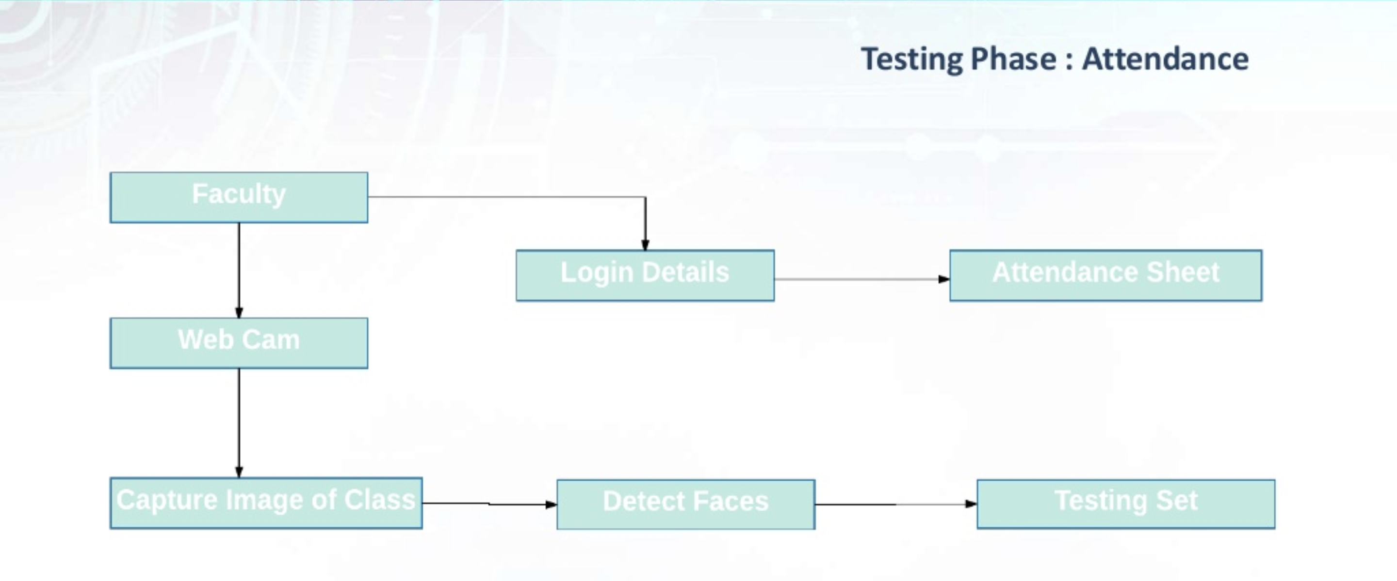

Slide 6
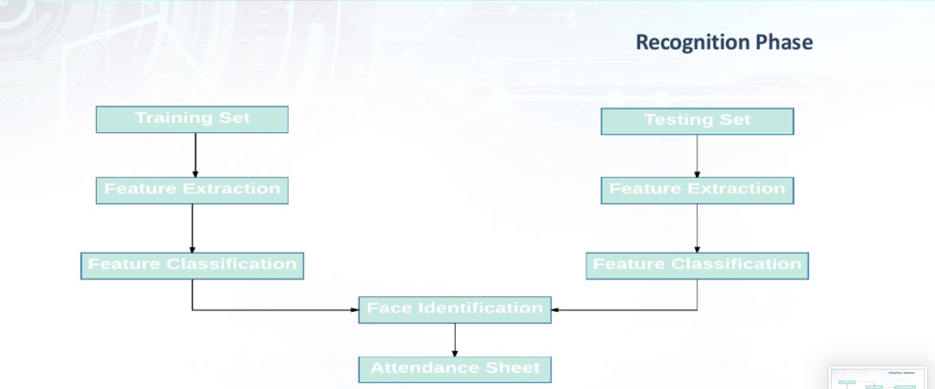

Slide 7
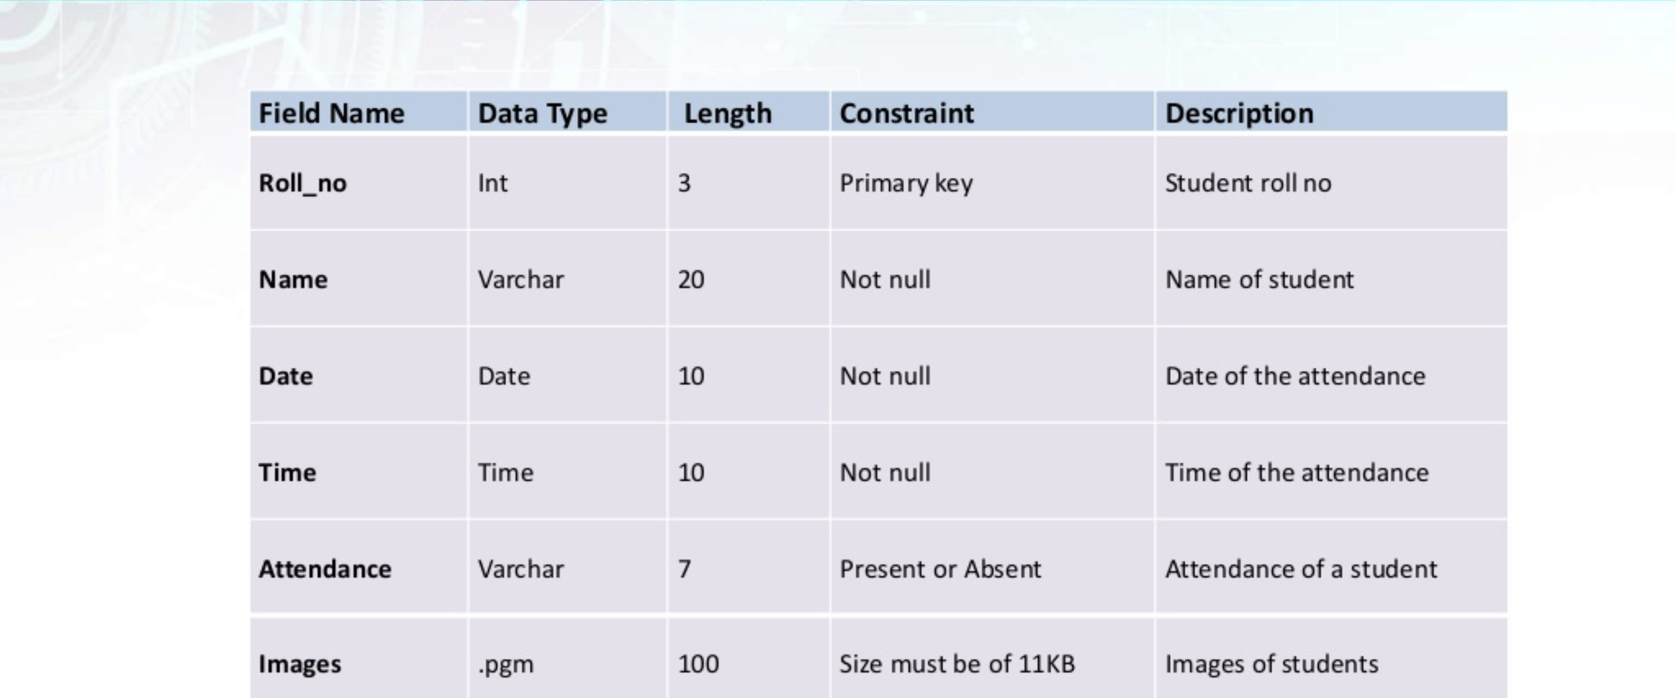
Database

Slide 8
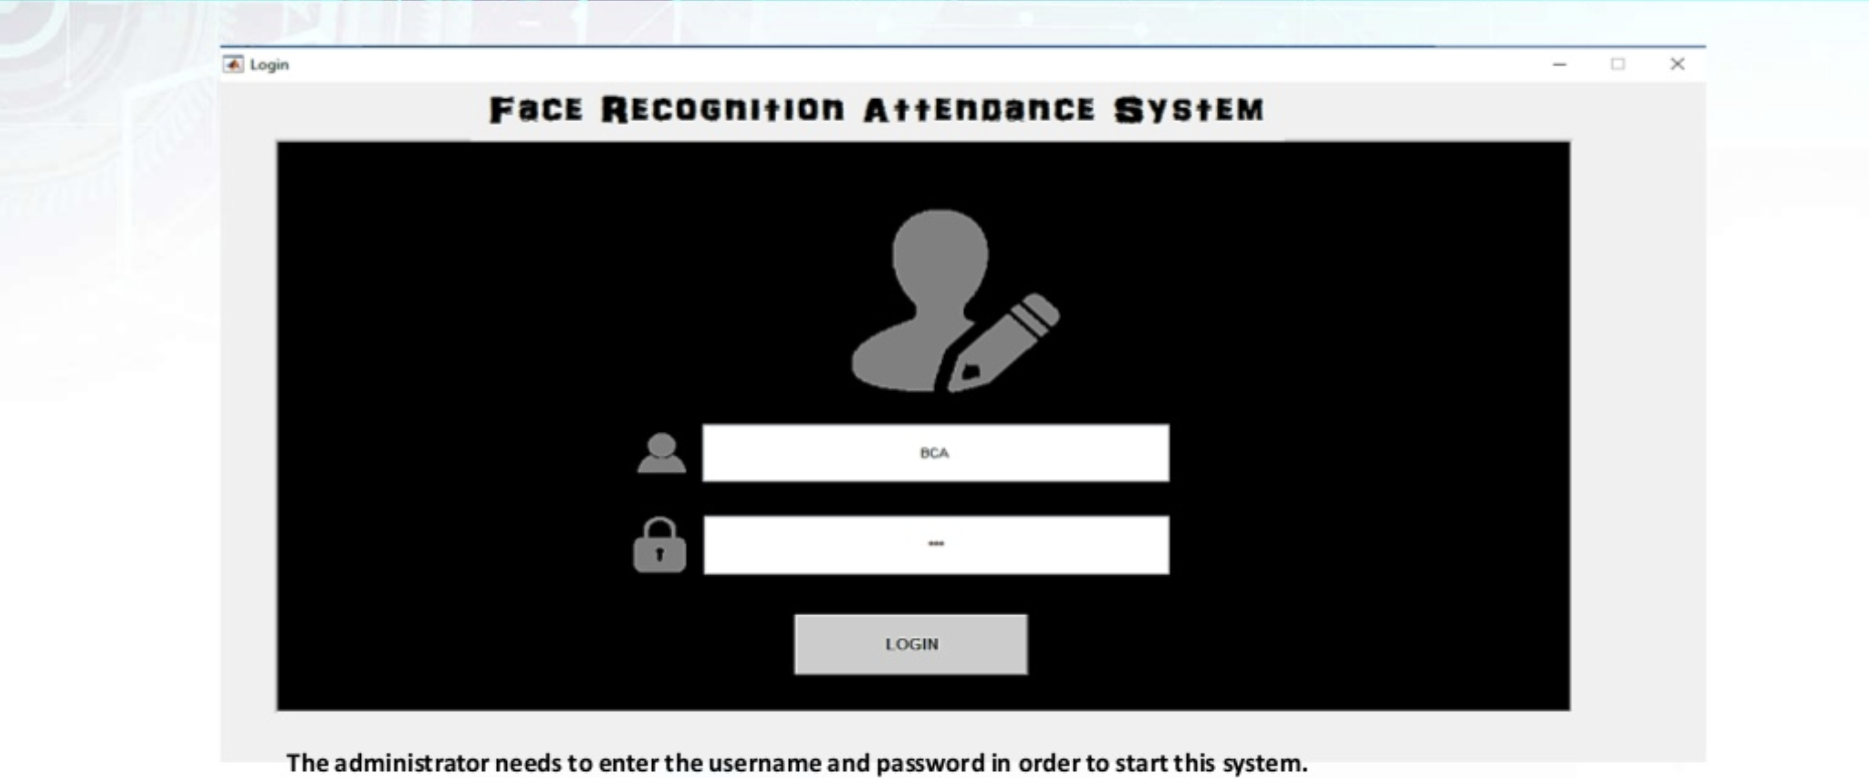

Slide 9
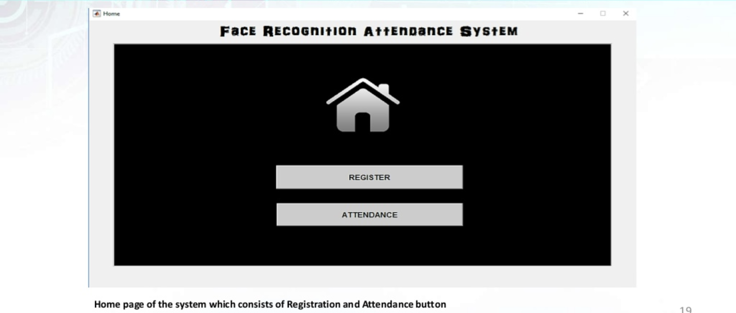

Slide 10
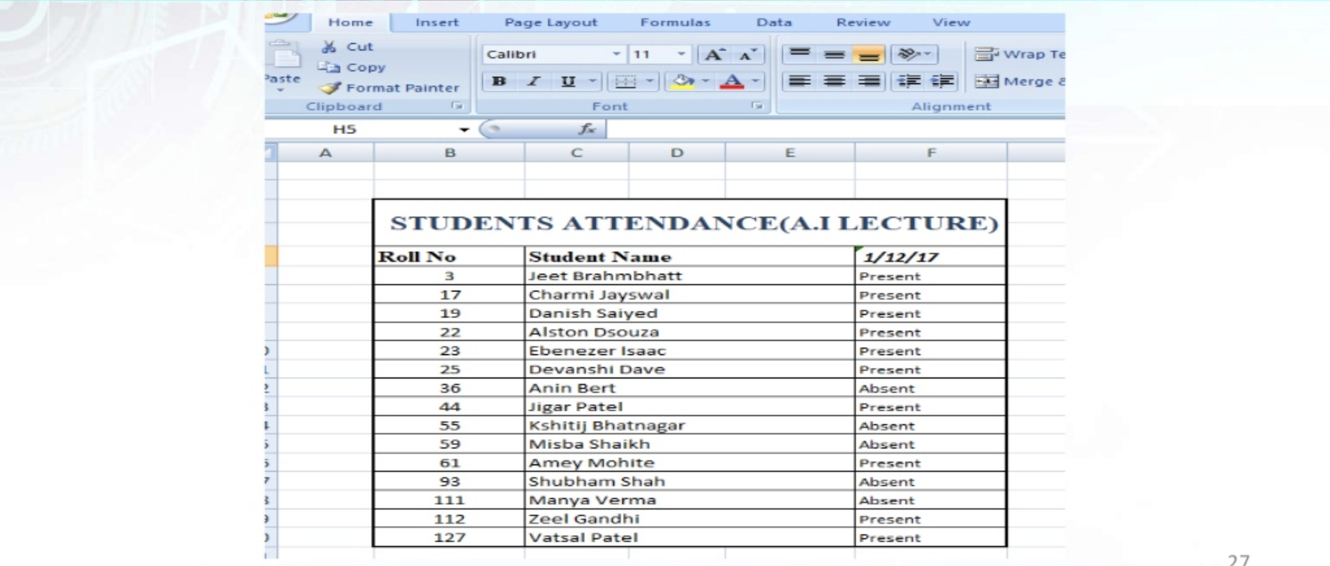

Slide 11
Challenges
Recognizing faces with video summarizations
Training data
Test data

Slide 12
Collaboration Plan
Offline face-to-face
Frequency: 2 or 3 times a week

Slide 13
Tools, Languages, Platforms
React
Spring
Heroku
Firebase
Kairos Face Recognition or any other Face Recognition API

Slide 14
References
https://www.researchgate.net/publication/317646924_Automatic_Attendance_Registration_System_based_Mobile_Cloud_Computing
https://nevonprojects.com/cloud-based-attendance-system/
https://ieeexplore.ieee.org/document/8776934
https://NaomiKulkarni/face-recognition-attendance-system-85321885

Slide 15
THANK YOU

